Slide 1
Adaptive Threat Hunting Packet Capture Framework For Enterprise Networks
TEAM-19
Smayan C Nandi 1RN22CY037
Varun Hegde 1RN22CY047
Vishruth M Hullatti 1RN22CY050
Guide
Dr. Kiran P
Professor and Head
Department of Computer Science and Engineering (Cyber Security)

Slide 2





Tribute to Our Founder
Our leaders
Dr. R N Shetty
Founder
1928 - forever

Slide 3
Agenda
Problem Statement
Literature Survey
Project Objectives

Slide 4
Problem Statement
Traditional Network Intrusion Detection Systems (NIDS) face major limitations in detecting modern cyber threats due to their static, rule-based approach.
Key Technical Limitations:
  Failure to detect zero-day attacks and APTs due to reliance on signature-based detection.
  High false positives caused by rigid, static rule configurations.
  Lack of self-learning mechanisms to adapt to evolving attack patterns.
  No automated threat mitigation — systems only log anomalies without proactive action.
  Poor multi-vector log correlation, analyzing logs in isolation without cross-pattern detection.
  Struggles to handle high-traffic networks with real-time efficiency.
  Heavy reliance on manual rule updates for new threat detection.

Slide 5
Literature Survey

Slide 6
Paper Title | Authors | Key Focus | Findings & Contributions | Technology
Automated Threat Hunting, Detection, and Threat Actor Profiling Using TIRA | Semi Yulianto, Gerard Nathaniel Cac Ngo | Introduction and evaluation of TIRA, a system designed for automated threat detection, log analysis, threat hunting, and threat actor profiling, optimized for low-computational environments. | Introduces a unified framework that speeds log analysis by 95.83%, provides automated threat classification and reporting, and remains accessible for low-resource organizations. | Python based threat detection with OWASP–MITRE integration.
A Systematic Analysis of Enhancing Cyber Security Using Deep Learning for Cyber Physical Systems | Shivani Gaba, Ishan Budhiraja, Vimal Kumar, Sheshikala Martha, Jebreel Khurmi, Akansha Singh, Krishna Kant Singh, S. S. Askar, Mohamed Abouhawwash | Deep learning-based cyberattack detection in Cyber-Physical Systems (CPS). | Analyzes various deep learning methods for detecting cyberattacks in CPS and discusses datasets used for training these models. | Deep Learning (CNN, RNN, Autoencoders) for intrusion detection
An Effective Classification of DDoS Attacks in a Distributed Network by Adopting Hierarchical Machine Learning and Hyperparameters Optimization Techniques | Sandeep Dasari, Rajesh Kaluri | DDoS attack classification using hierarchical machine learning. | Uses a hierarchical ML-based approach with hyperparameter tuning, achieving 99.77% accuracy in detecting DDoS attacks. | Machine Learning (XGBoost, LGBM, CatBoost, Random Forest, Decision Tree)
An Explainable and Resilient Intrusion Detection System for Industry 5.0 | Danish Javeed, Tianhan Gao, Prabhat Kumar, Alireza Jolfaei | Explainable AI for intrusion detection in Industry 5.0 environments. | Proposes an intrusion detection system (IDS) combining BiLSTM, Bi-GRU, and SHAP for model interpretability. | Deep Learning (BiLSTM, Bi-GRU) with Explainable AI (SHAP)
A Comprehensive Survey: Evaluating the Efficiency of Artificial Intelligence and Machine Learning Techniques on Cyber Security Solutions | Merve Ozkan-Okay, Erdal Akin, Ömer Aslan, Selahattin Kosunalp, Teodor Iliev, Ivaylo Stoyanov, Ivan Beloev | Overview of AI and ML applications in cybersecurity, including intrusion detection, malware detection, and adversarial attacks. | Evaluates state-of-the-art ML, DL, and RL models in cybersecurity and discusses challenges such as adversarial robustness and data quality. | AI/ML (Deep Learning, Reinforcement Learning, ChatGPT for cybersecurity)

Slide 7
Objectives
Real-time packet capture and logging — Continuously capture packets, extract flow features, and log detections and metadata to CSV for audit and analysis.
Hybrid detection engine — Combine lightweight rule-based detection (SYN flood, ICMP flood, port-scan) with flow-level ML classification to identify malicious activity.
Attack event logging and timeline — Persist canonical attack events with references to flows and evidence for triage and reproducibility.
OWASP-based taxonomy and enrichment — Annotate detected events with OWASP Top-10 categories to standardize vulnerability/attack classification and support reporting.

Slide 8
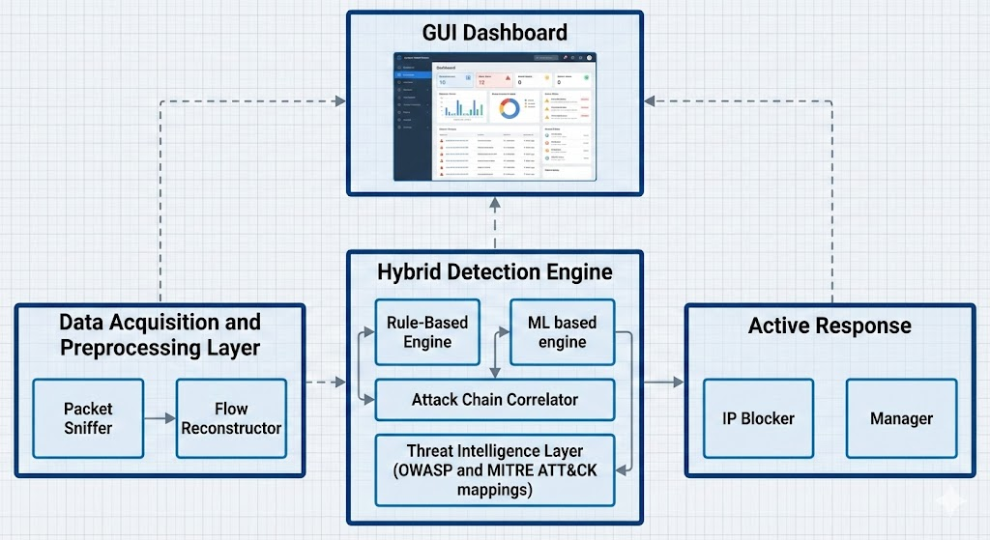
Architecture Diagram

Slide 9
Technologies / Languages Used
Python 3 — Core programming language used to build the packet sniffer, flow tracker, ML detection engine, and API client modules.
Scapy — Python library for real-time packet capture, protocol parsing (TCP/UDP/ICMP), and low-level network inspection.
Joblib & NumPy — Used to load the pre-trained ML model (CICIDS-based) and perform feature extraction, numeric computation, and flow-level analytics.
iptables (Linux firewall tool) — Used for automated blocking and unblocking of suspicious IP addresses based on detection events.

Slide 10
Implementation
Packet Capture Module: Uses Scapy to sniff live traffic from the network interface and extract packet metadata such as IPs, ports, protocols, flags, and payload size.
Rule-Based Detection Engine: Detects SYN floods, ICMP floods, and port scans using threshold-based logic (e.g., SYN count > 10 triggers blocking).
Machine Learning Detection Module: Tracks packet flows, extracts statistical features, and uses a trained ML model to classify traffic as benign or malicious.
Threat Correlation Engine: Maps detected attacks to OWASP Top-10 categories, providing contextual interpretation and remediation guidance.

Slide 11
Implementation (Contd)
Attack Chain Detection: Links multiple events from the same attacker IP to identify multi-stage attacks (e.g., SYN Flood → Port Scan).
Blocking and Response Module: Automatically blocks attacker IPs using firewall rules and unblocks them after the configured timeout.
GUI Dashboard: Displays live detection events, blocked IPs, and flow stats for easy operator visibility.

Slide 12
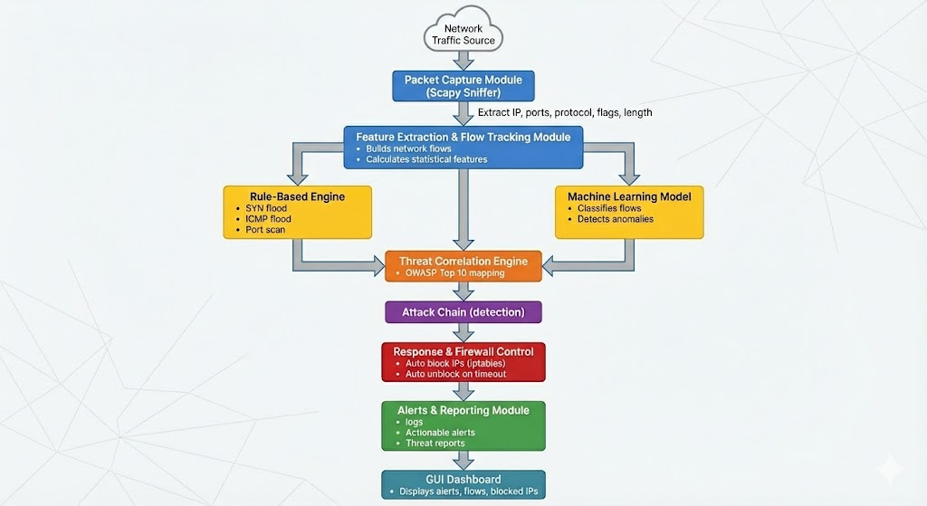
Flowchart

Slide 13
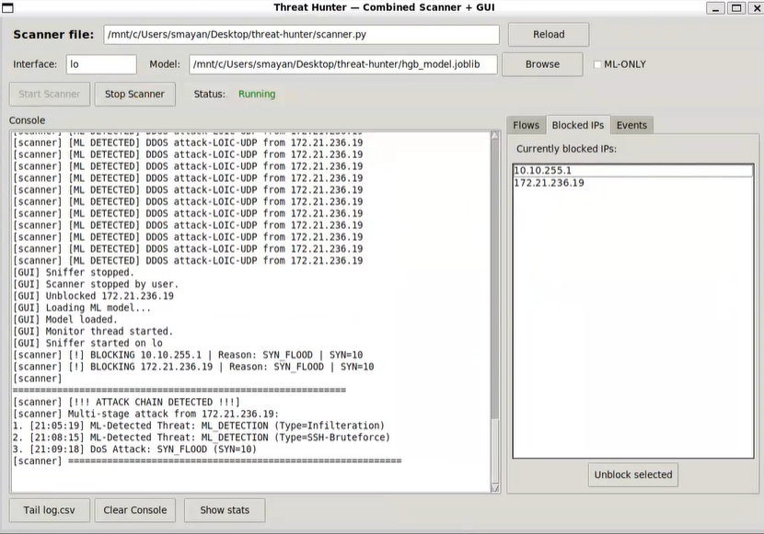
Results and Discussion
The screenshot shows a tool GUI detecting a SYN flood DoS attack in real time. As packets are analyzed, the system identifies repeated SYN requests from suspicious IP addresses with abnormal counts (e.g., SYN=10), flags them as DoS/SYN Flood attacks, and automatically blocks the attacking IPs. The console logs show detection alerts, attack classification (SYN Flood), and mitigation actions such as adding the attacker’s IP to the blocked list.

Slide 14
Results and Discussion (Contd)
The system accurately detected attacks such as SYN floods, port scans, and DoS events in real time while automatically blocking malicious IPs and reducing manual effort.
The GUI and logs clearly presented threats, alerts, and attack chains, improving analyst visibility and response.
Automated detection significantly reduced analysis time from hours to minutes compared to manual investigation.
Deviations observed included occasional false positives and the need for improved phishing or social-engineering detection, guiding future work directions.

Slide 15
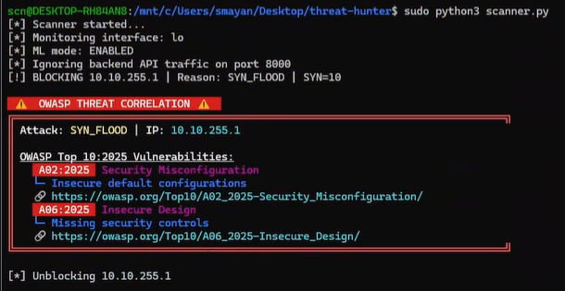
The image shows the system detecting a SYN Flood attack and automatically correlating it with relevant OWASP Top 10 vulnerabilities. In this case, the attack is mapped to issues such as Security Misconfiguration (A02:2025) and Insecure Design (A06:2025), helping analysts understand which weaknesses may have enabled the attack and providing direct links for remediation guidance.

Slide 16
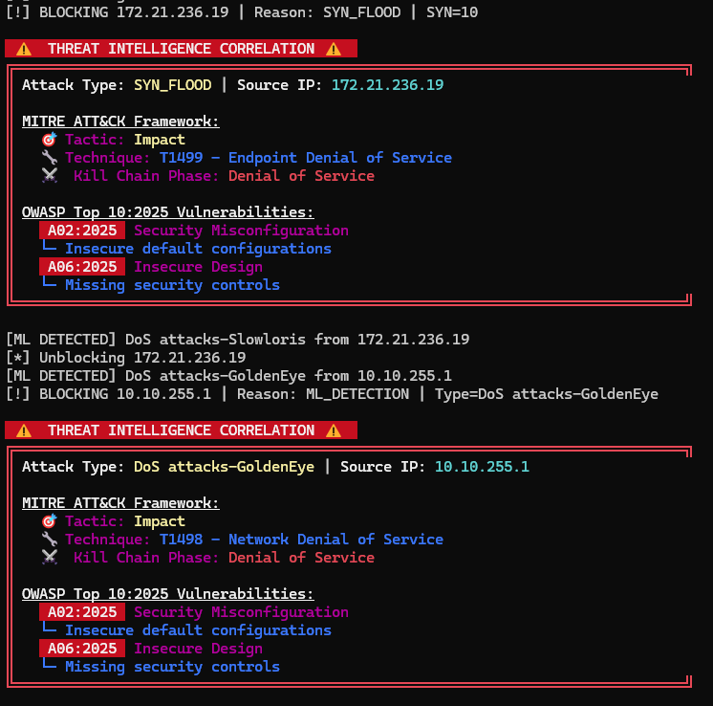
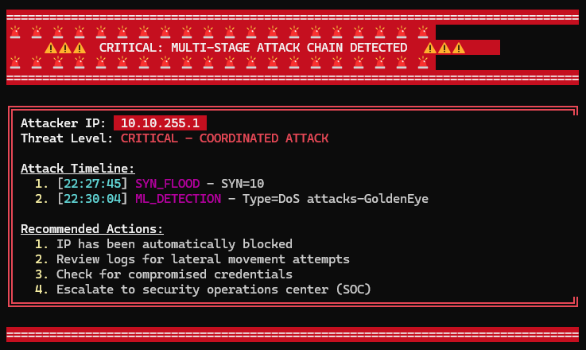

Slide 17
Conclusion
Our project successfully delivers an automated, real-time threat hunting system capable of detecting network intrusions with high accuracy while minimizing manual effort. By combining rule-based detection, machine learning, and OWASP-integrated threat correlation, the system provides meaningful insights, fast response actions, and actionable reporting. The results demonstrate significant reductions in analysis time and improved visibility into attack behaviors, proving the solution’s effectiveness for organizations with limited cybersecurity resources. Overall, the project meets its objectives of enabling faster detection, stronger situational awareness, and more efficient security operations.

